Slide 1
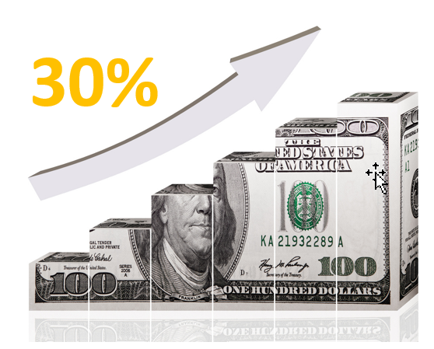
Mall without WallS
Notes:
2017 vs 2016 commission up 30%
2017 vs 2014 377% increase

Slide 2
Master UFO ProgramME
A STRUCTURED SYSTEM THAT IDENTIFIES AND QUANTIFIES WHAT SUCCESSFUL UNFRANCHISE® OWNERS DO.
The Shopping Annuity®
Convert Spending Into Earning
Notes:
Why?

Slide 3
Results that speak for themselves.
1. Regular UFO vs a MASTER UFO
2. Regular UFO vs SAMM
Results
≥2 years, but <3 years:
+ 48%: Master UFO earns 48% more than UFO annually
+197%: SAMM earns 197% more than UFO
2. ≥3 years, but <5 years :
48.4%: Master UFO earns 48.4% more than UFO annually
+ 147%: SAMM earns 147% more than a UFO
. ≥5 years, but <7 years :
+ 102%: Master UFO earns 102% more than UFO annually
+282%: SAMM earns 282% more than a UFO
Speak for themselves.
Notes:
Results that speak for themselves. Data reports and Statistical Analysis comparing UFO’s, Master UFO’s SA Members, and SA Master Members

Slide 4
Master UFO Programme
A STRUCTURED SYSTEM THAT IDENTIFIES AND QUANTIFIES WHAT SUCCESSFUL UNFRANCHISE® OWNERS DO.

Slide 5
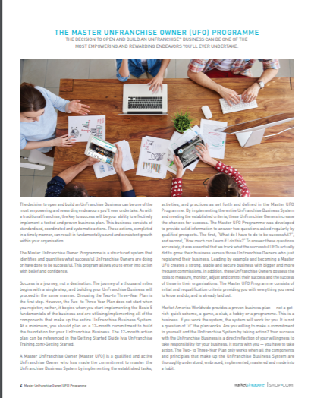
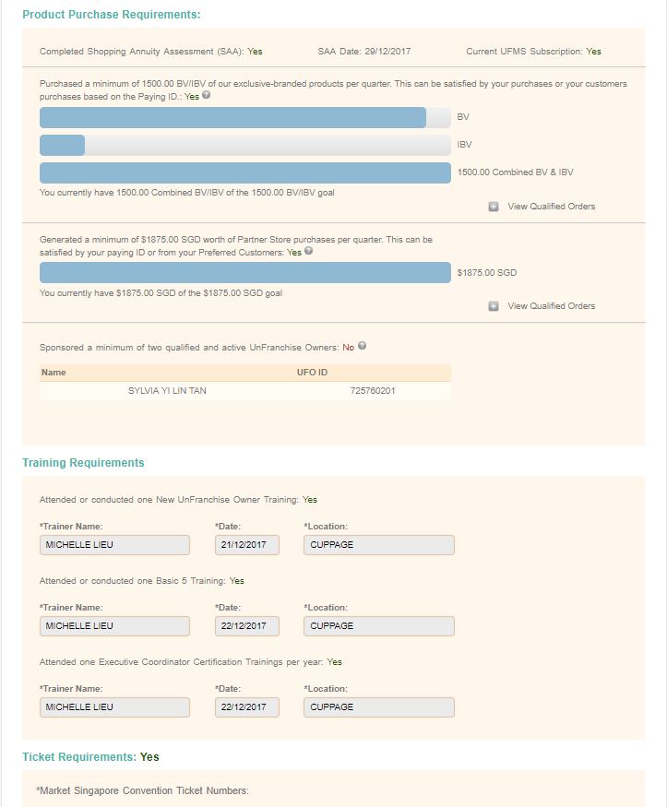
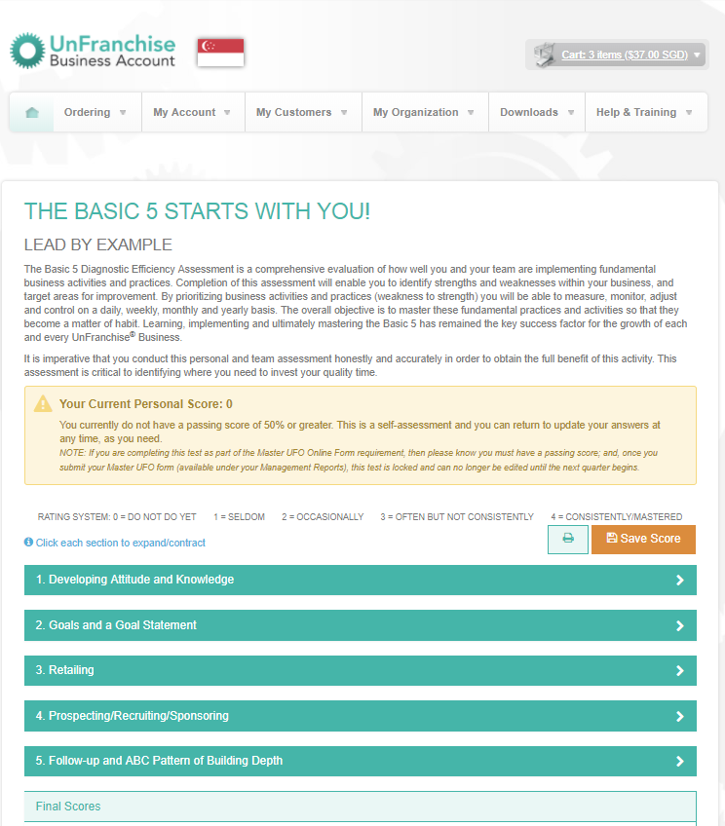
Master ufo programme Online TOOLs

Slide 6
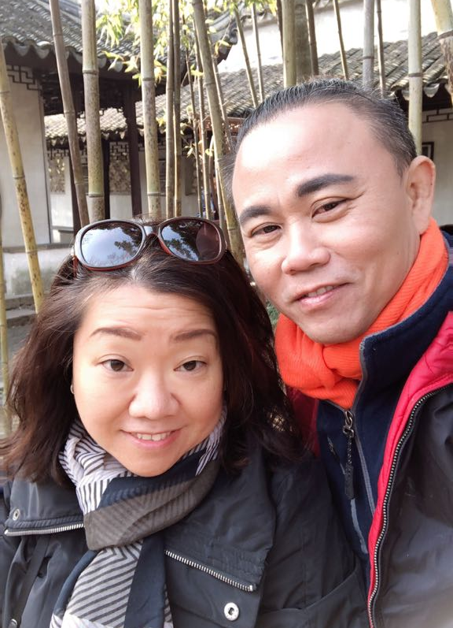
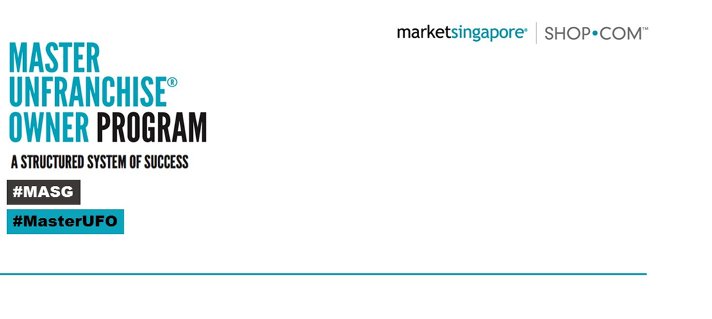
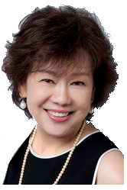
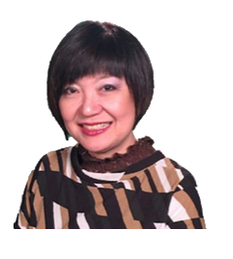
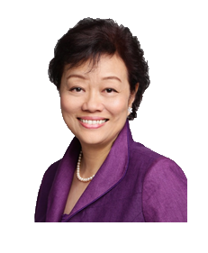
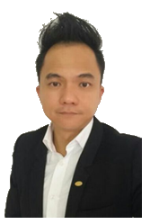
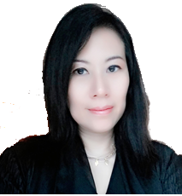
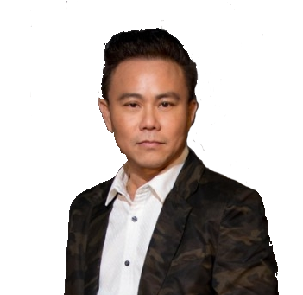
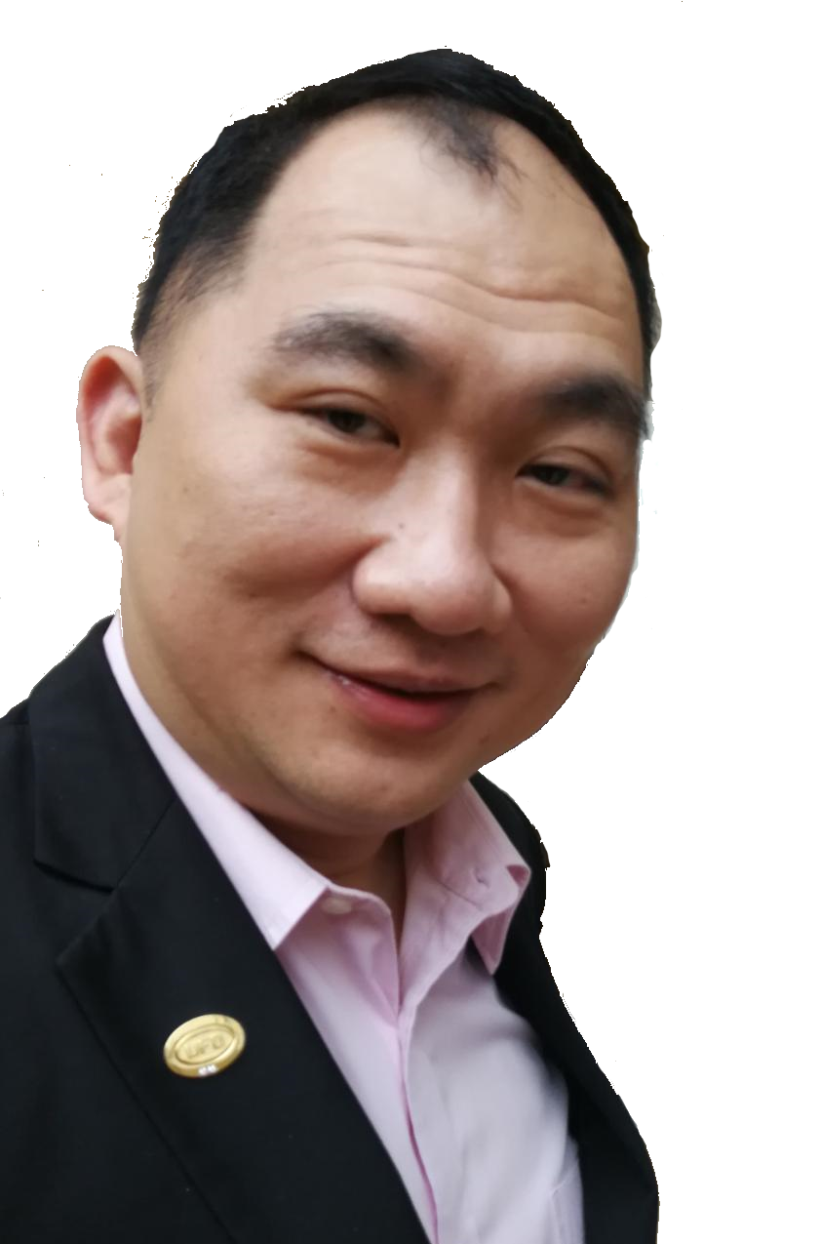
Master ufo programme- video
Liyen Ho
FVP
Michelle Lieu
NSC
Bobby Ho
SC
Jessica Lee
PC
Emily Quek
PC
Ruby Chan
PC
Marcus Schaech
PC
Ronald Ho
SMC
Verna Tay
MC
Normanic Ho
MC
Edwin Soon
MC

Slide 7
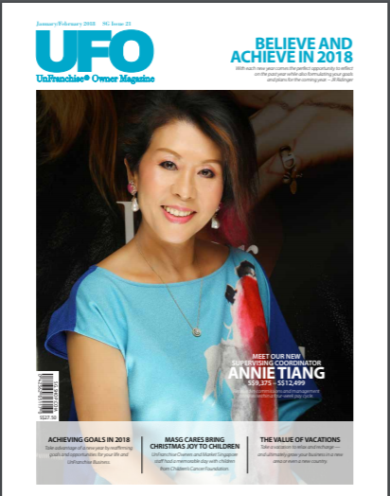
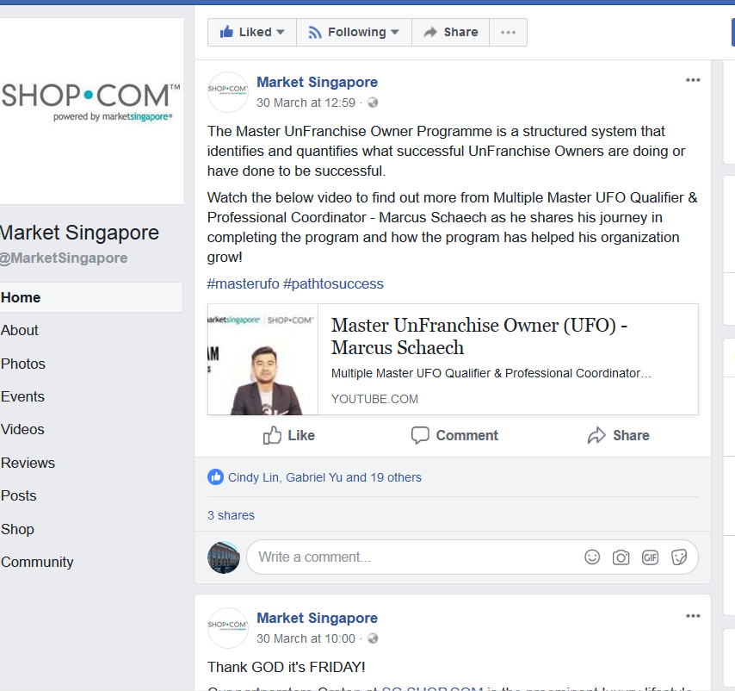
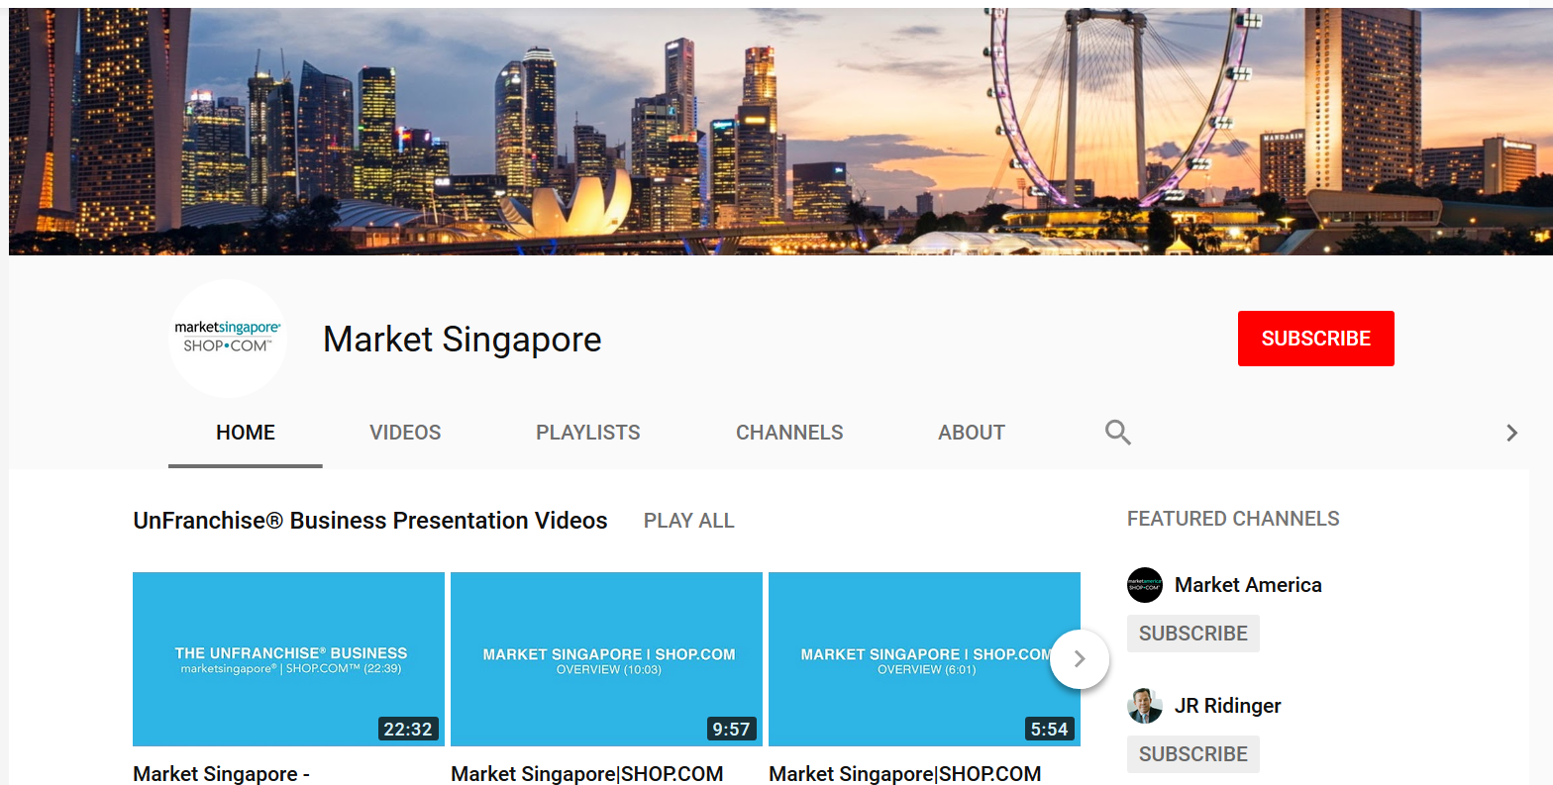
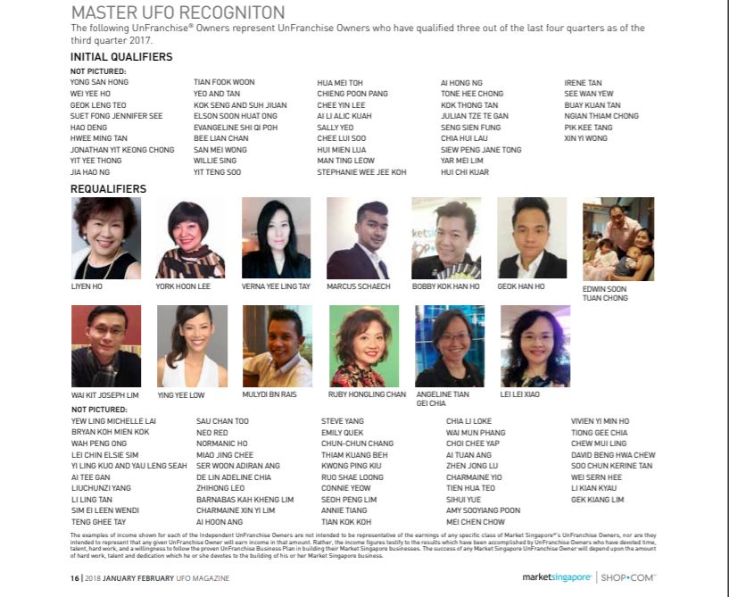
Master ufo programme Recognition

Slide 8
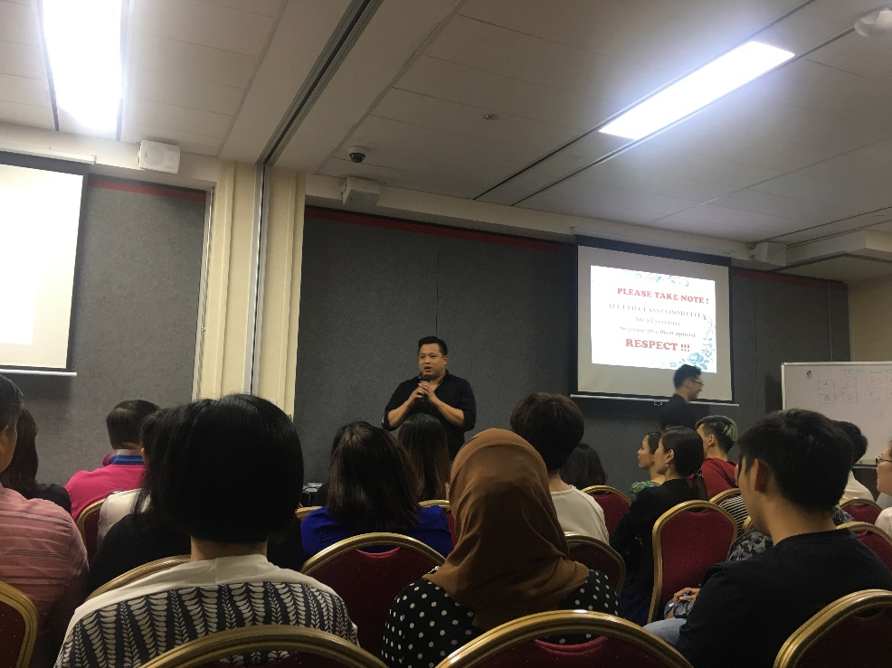
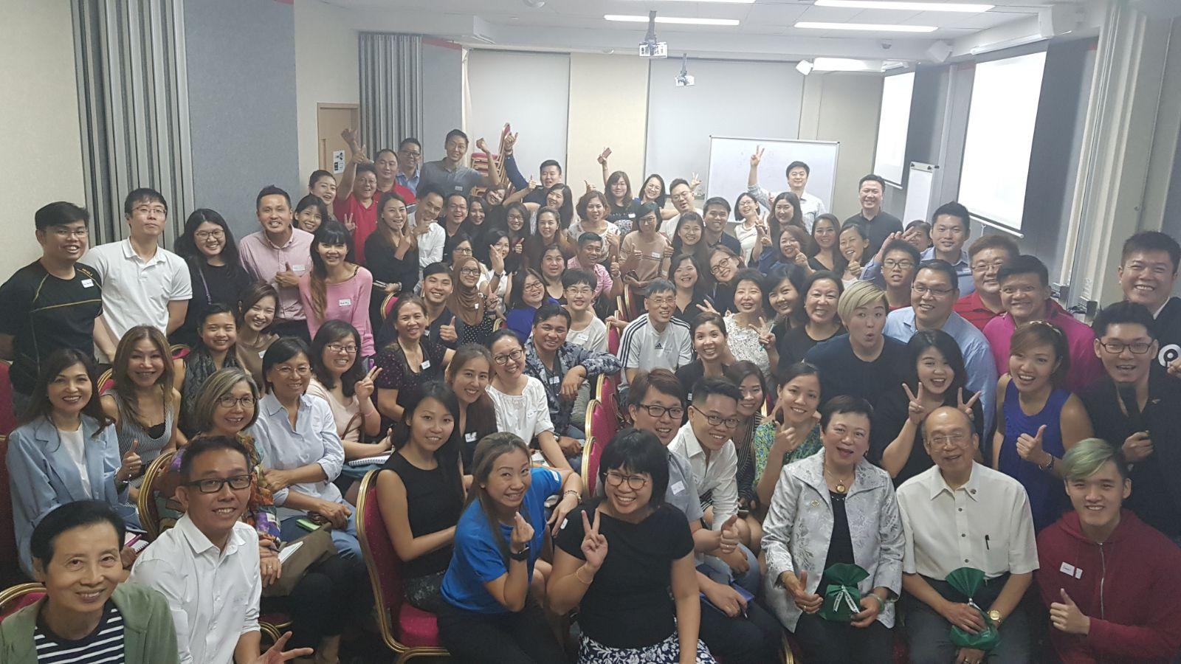
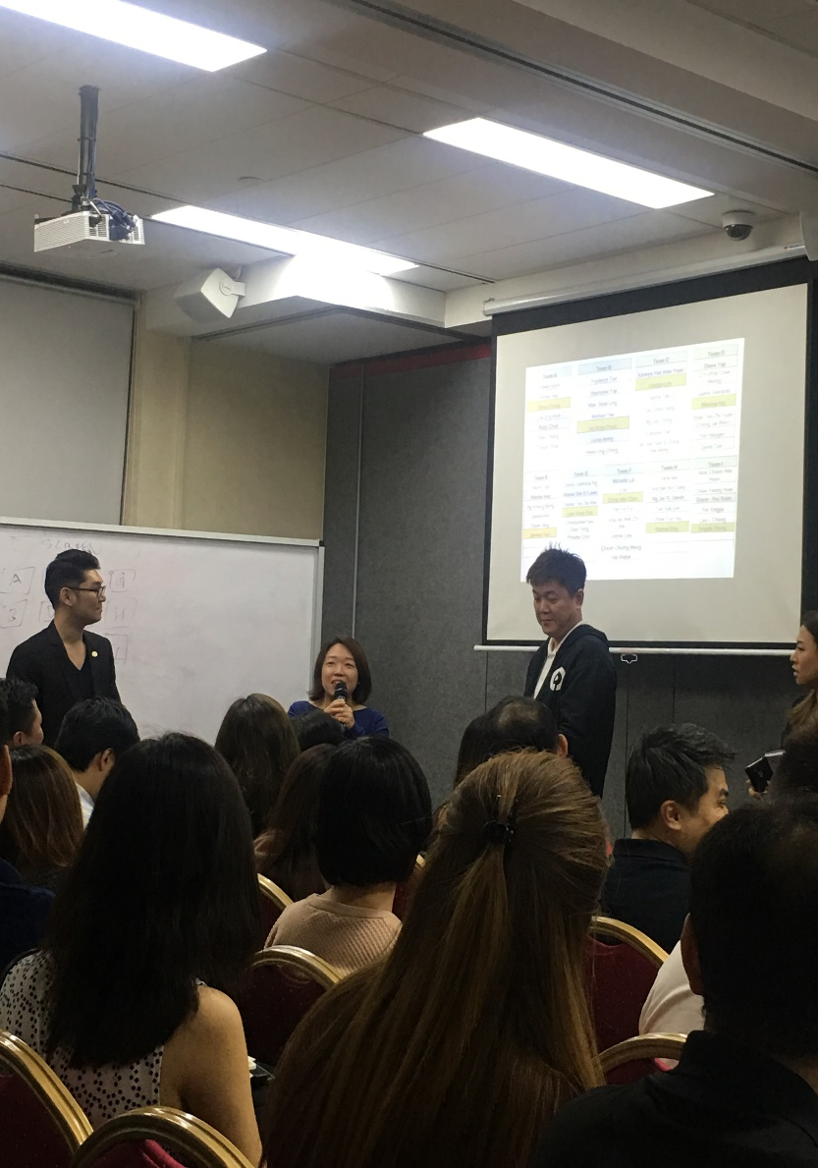
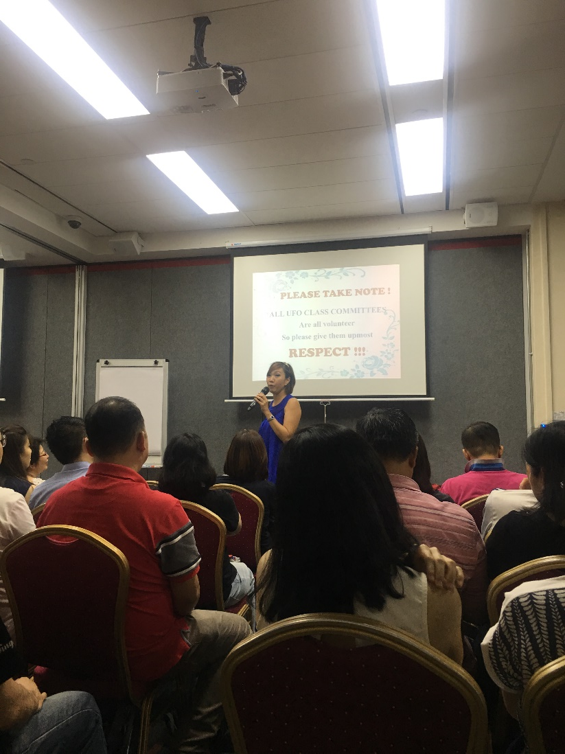
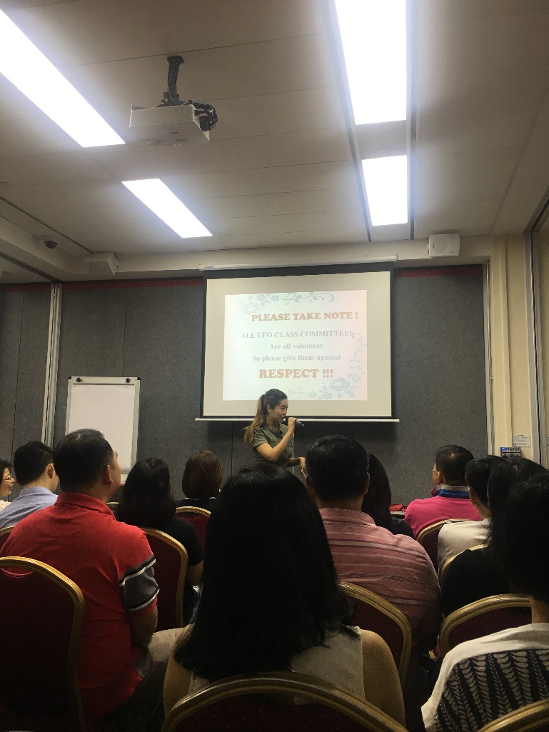
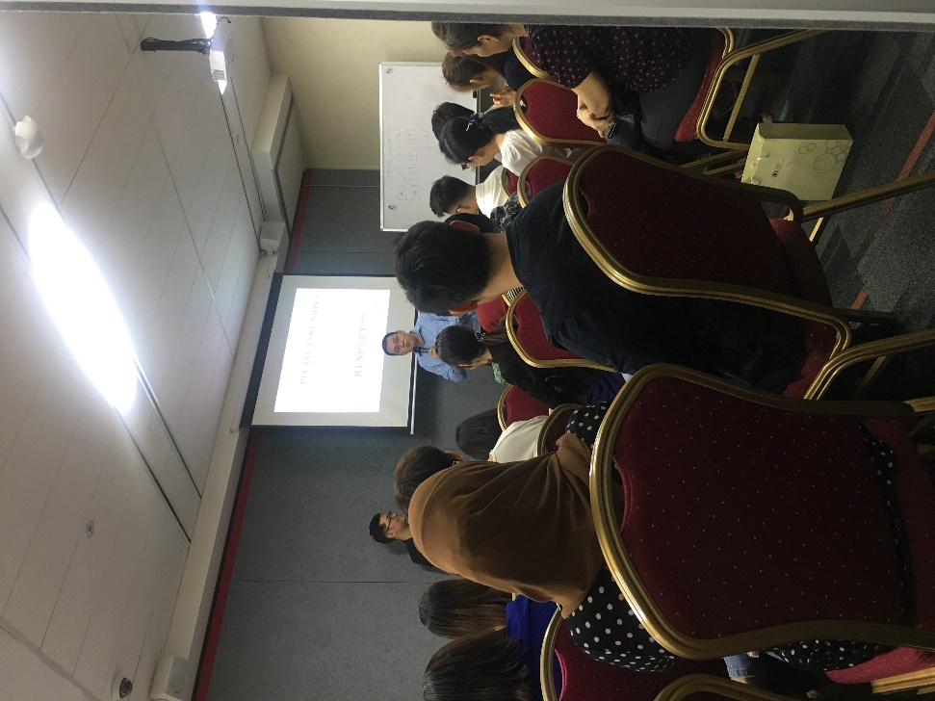
master ufo PROGRAMME CLASS

Slide 9
The Shopping Annuity®
Convert Spending Into Earning
Notes:
Every UFO ultmate target is to flush weekly 5000 BV/IBV left and right. Do you want to want to manage 50 customers who buy 100 BV or you want 10 customers buy 500 BV?
It is simple concept of helping your customer to change what they have been spending to what you have on your portal…

Slide 10
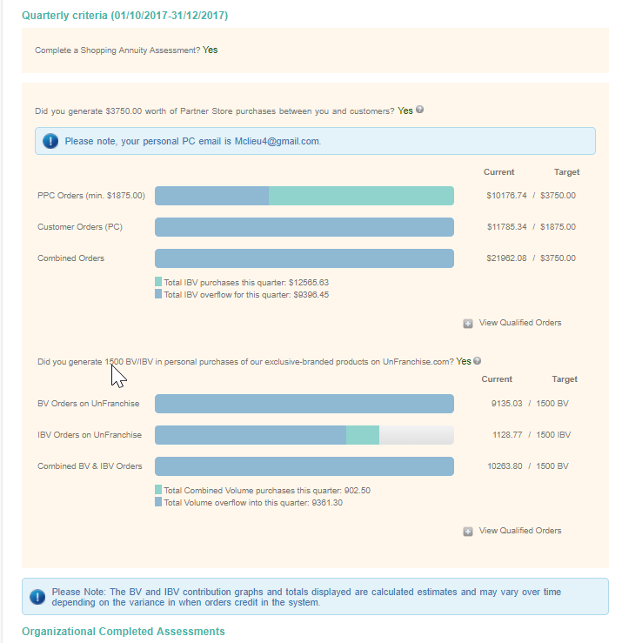
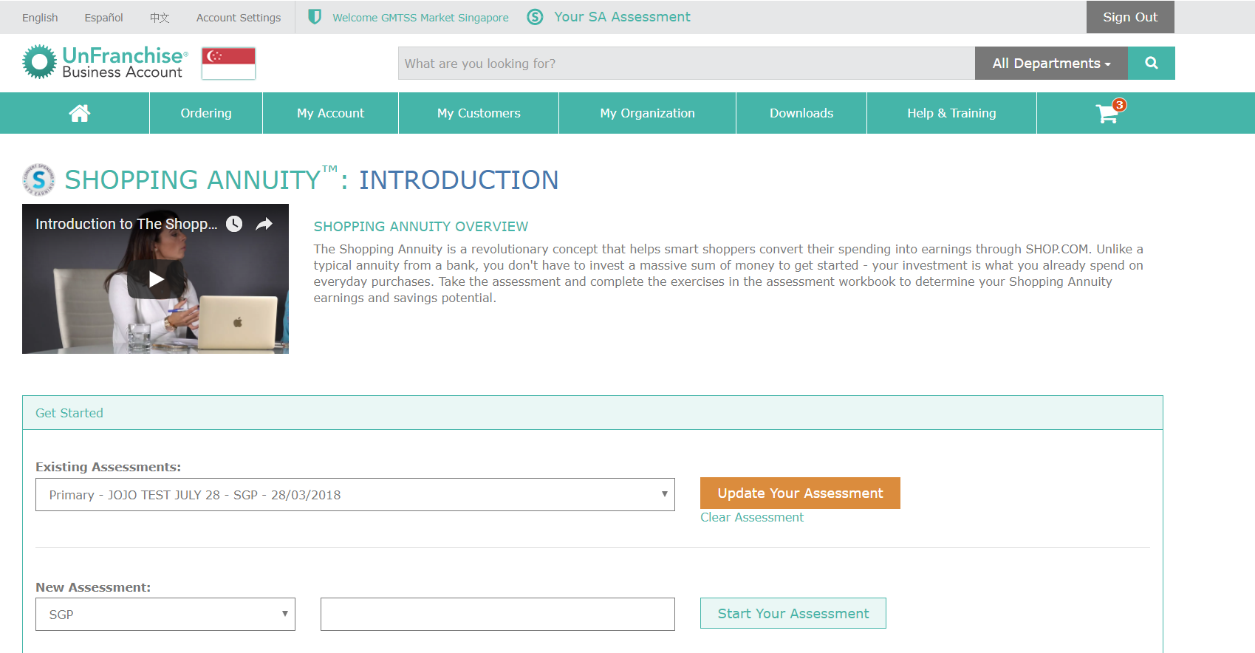
SHOPPING ANNUITY programme Online TOOLs

Slide 11
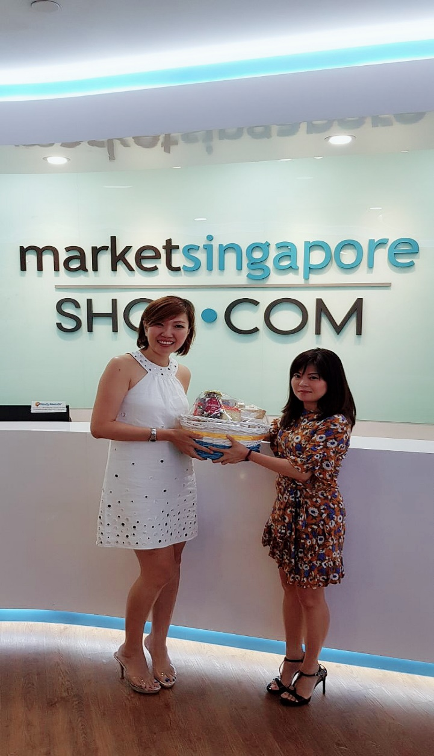
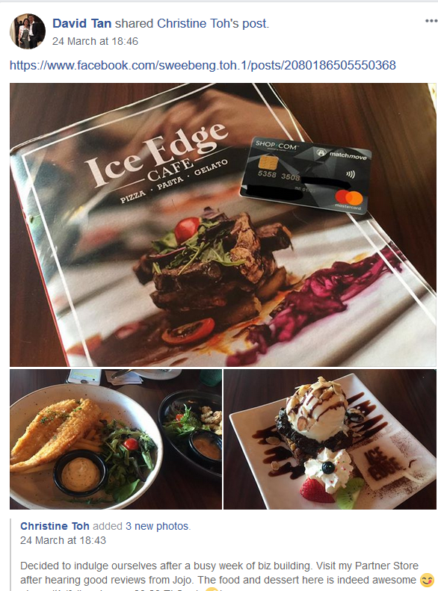
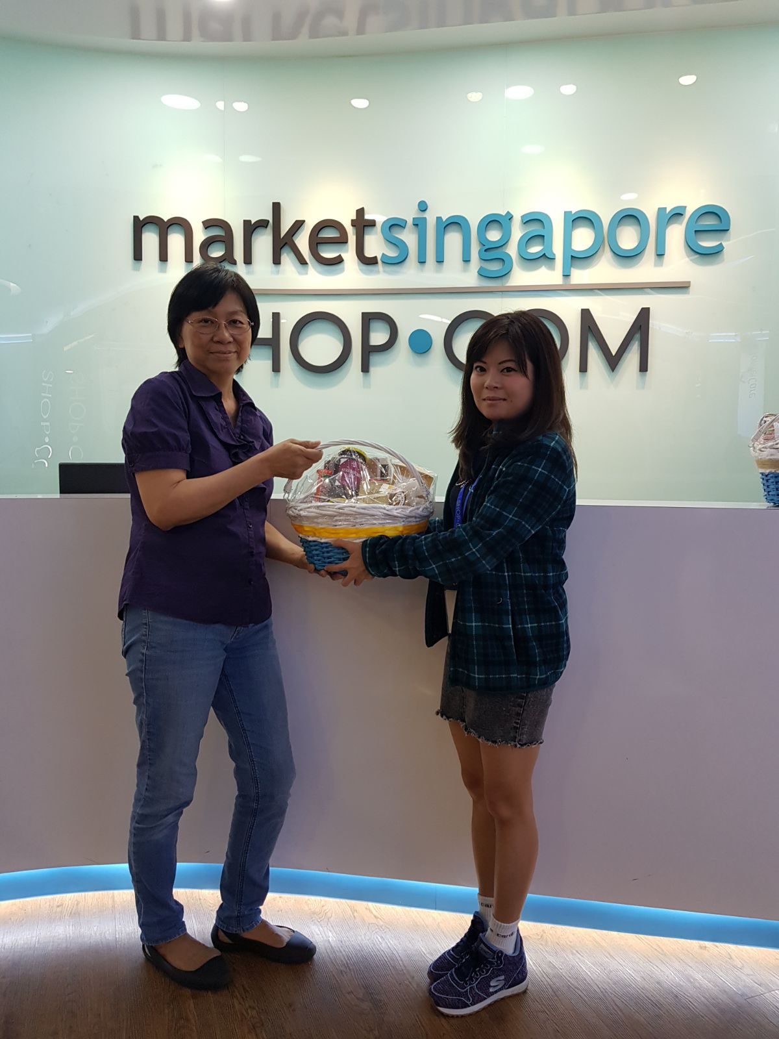
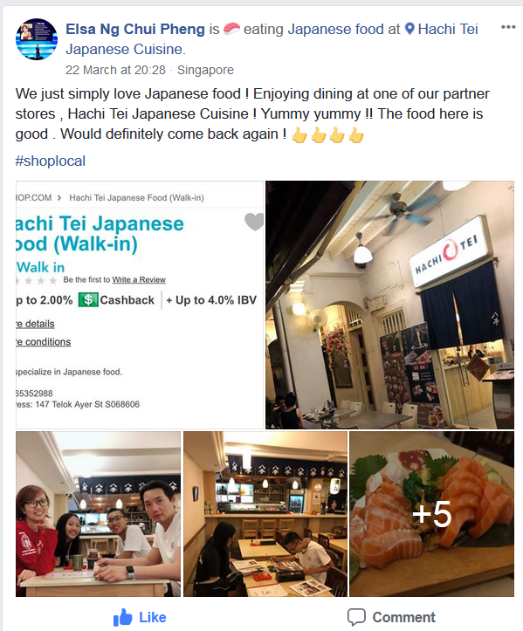
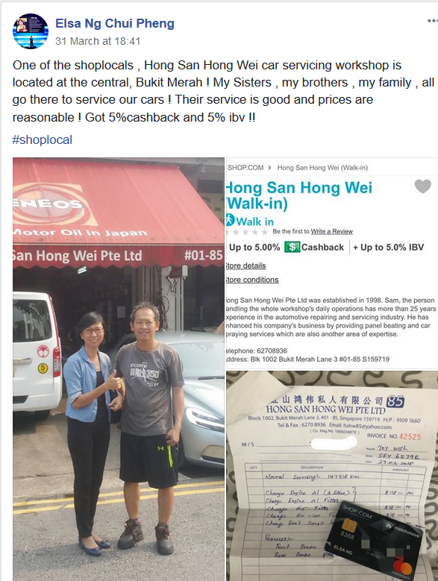
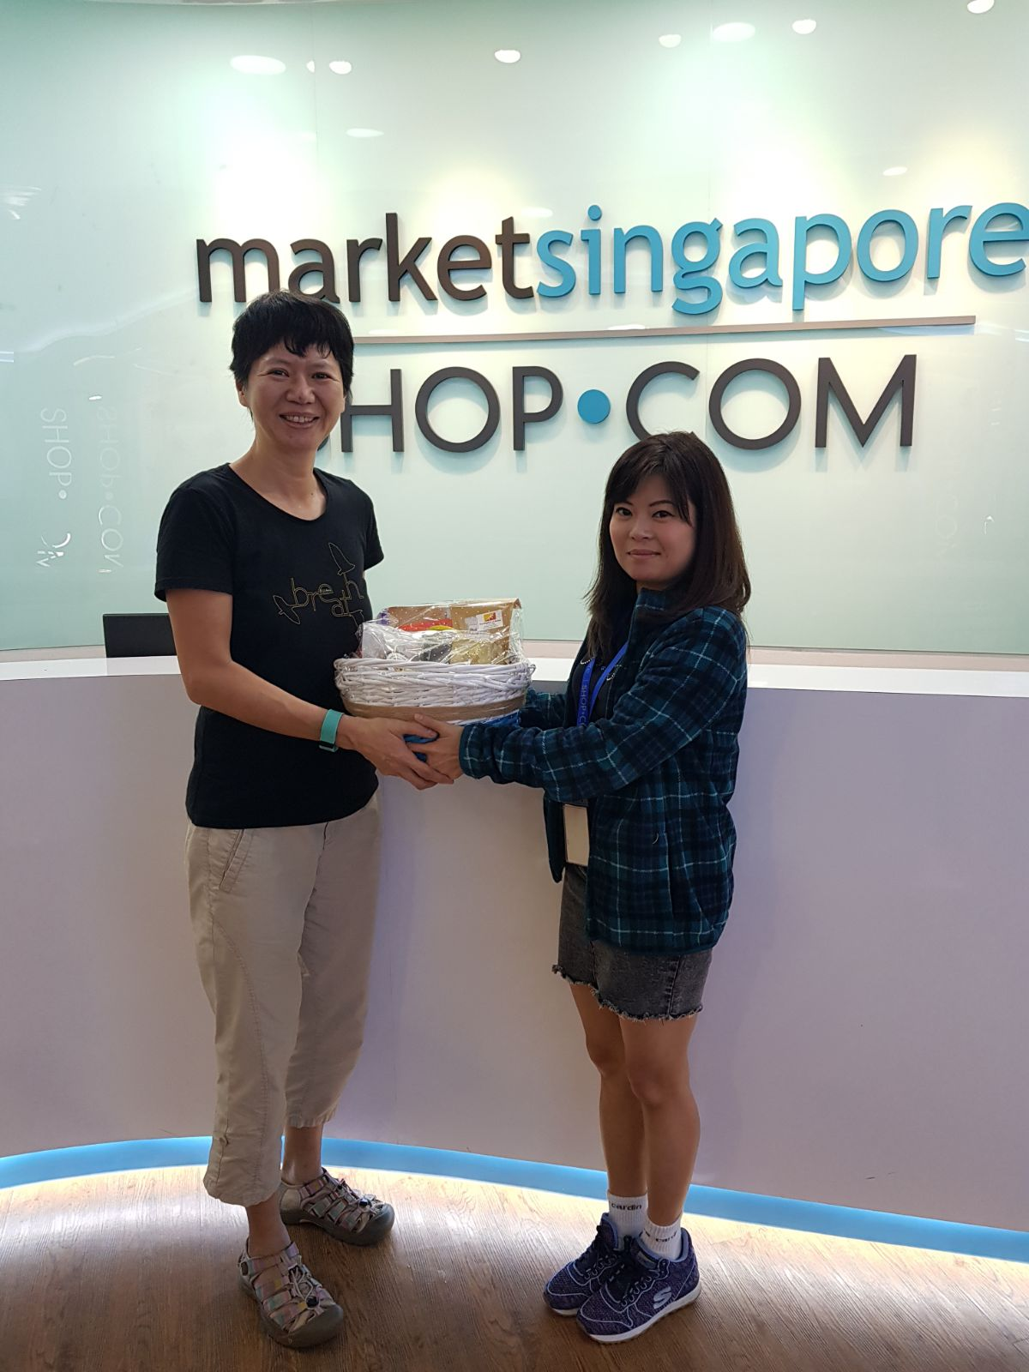
SHOP LOCAL PROGRAMME

Slide 12
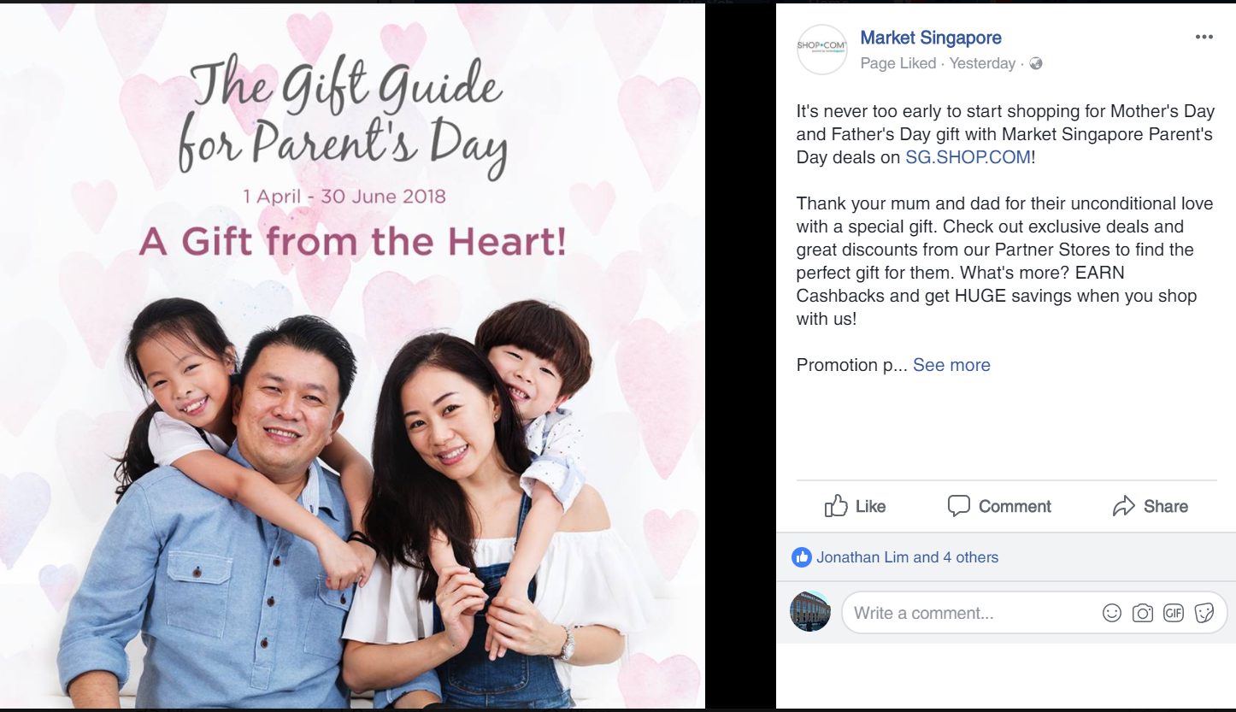
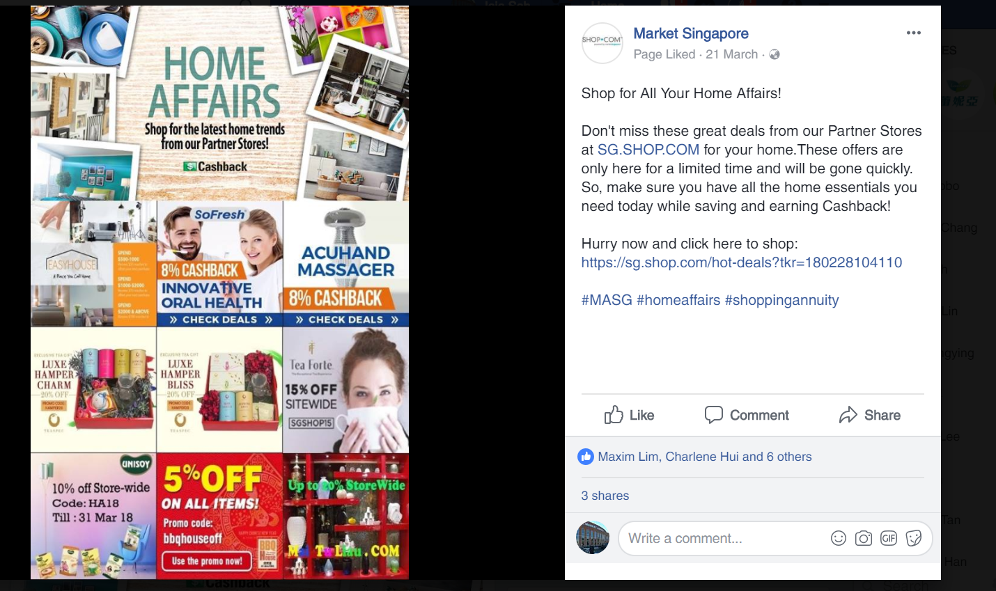
CAMPAIGNS & PROMOTIONS

Slide 13
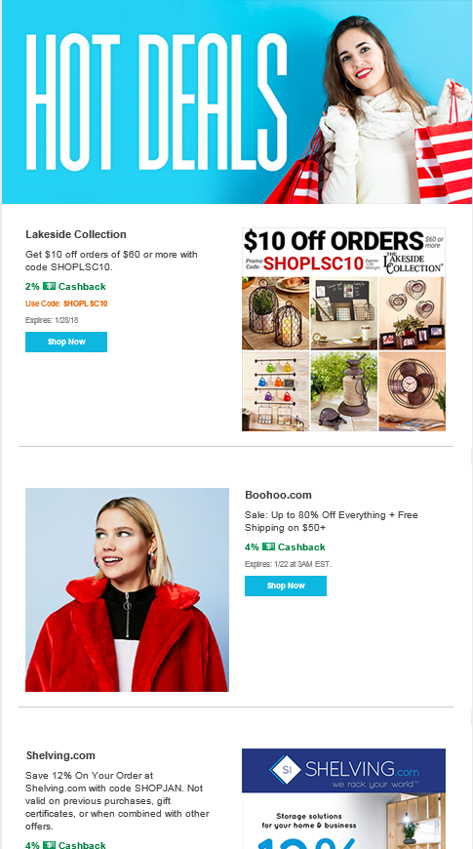
New marketing email

Slide 14
Features on magazine

Slide 15
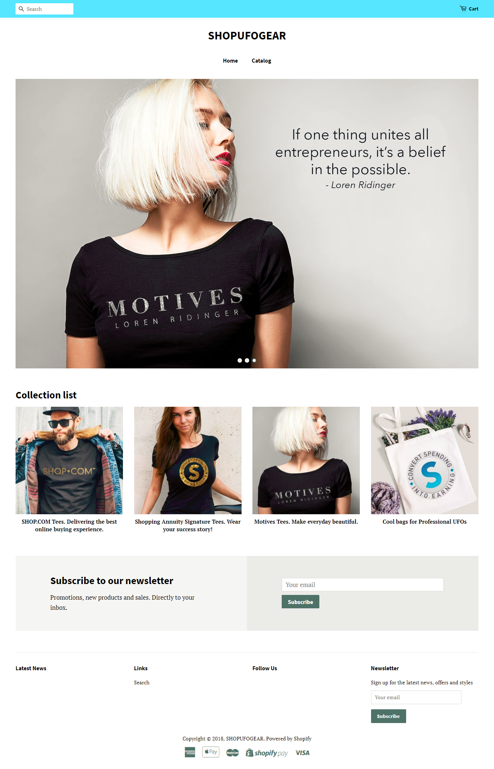
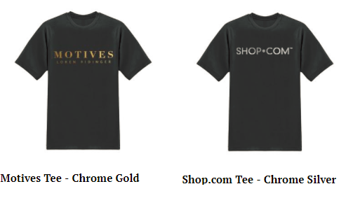
SHOPUFOGEAR.COM
MERCHANDISE

Slide 16
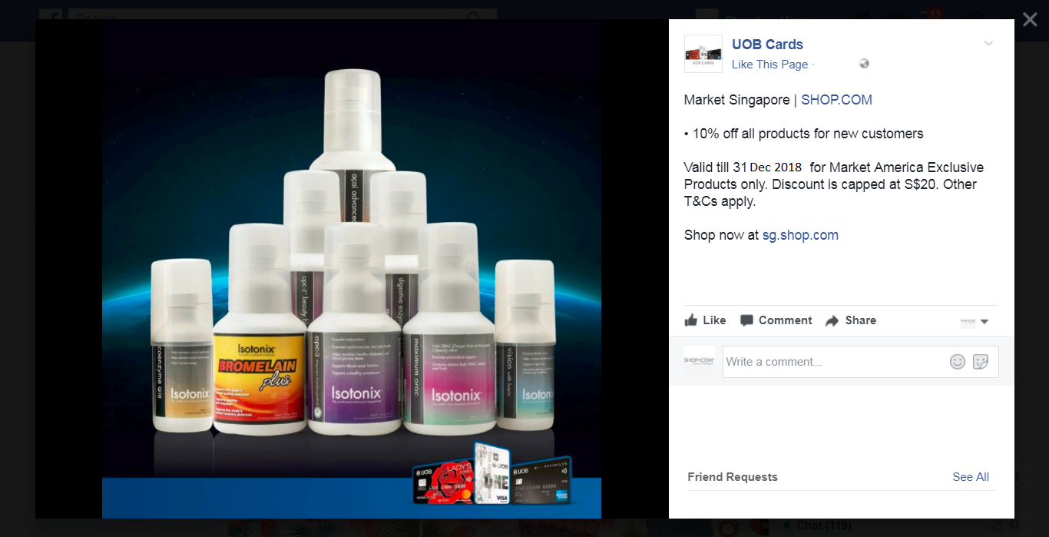
united overseas bank

Slide 17
UNFRANCHISE
Notes:
So now, what have you done for your unfranchise business? And what will you be doing to move to your target?

Slide 18
RESULT PRODUCING ACTIVITIES
Use and Sell the PRODUCTS – Match Product to People
Share the BUSINESS OPPORTUNITY – Show Plan
Share EDUCATION - How many tickets do you have to the next event?
Share SHOPPING ANNUITY Concept : How many people you have help to convert their spending into earnings by going through shopping annuity assessment?
Notes:
Have you consistently work on and focus on the 4 result producing activities? So every minutes of your time count?

Slide 19
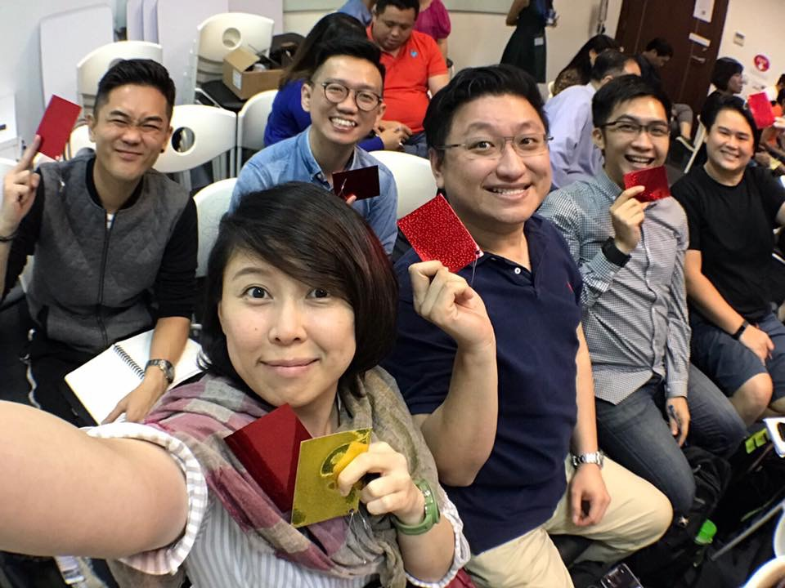
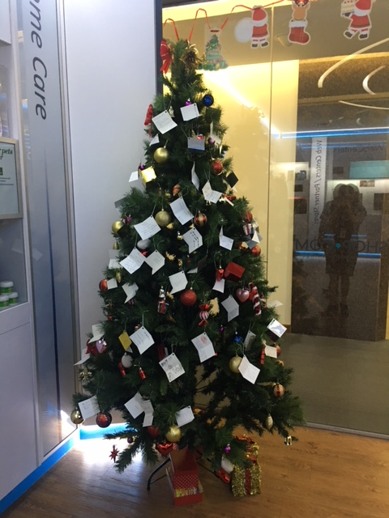
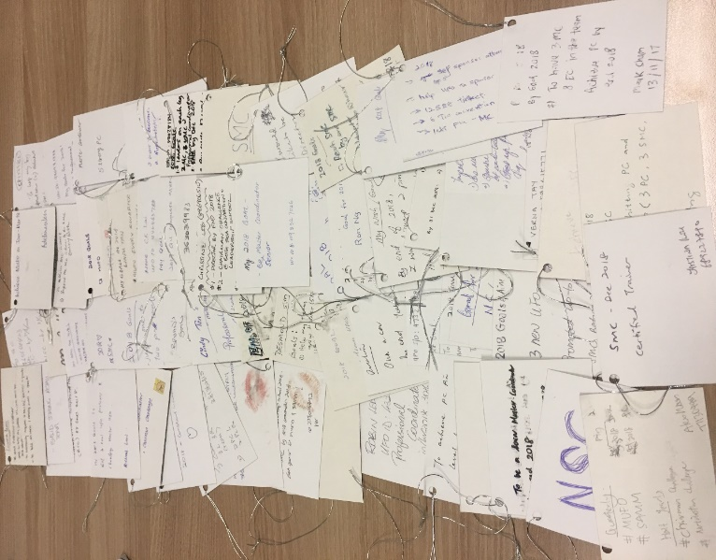
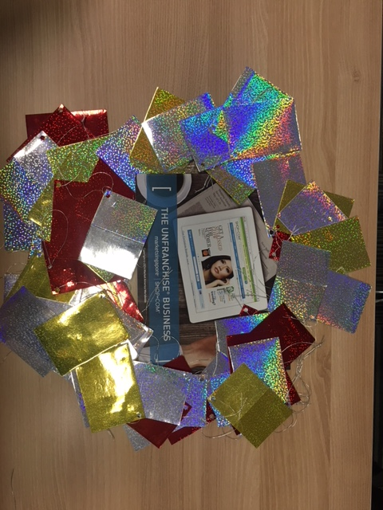
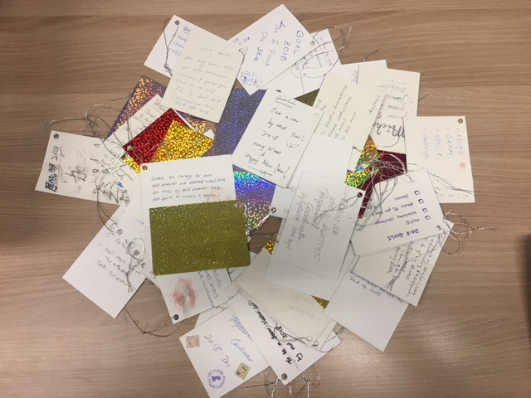

Slide 20
Notes:
You need to position yourself for success and you know the best way is?

Slide 21
MarketSingapore®|SHOP.COM
Match Product to People,
Match People to Product!
Notes:
We are product brokerage and internet marketing company specialize in one to one marketing..
We sell all kind of product that in need by the consumers…. And we have wide range of product you can use and sell… now we are now new product I wish to share with in this convention….. Guess what
Cue video

Slide 22
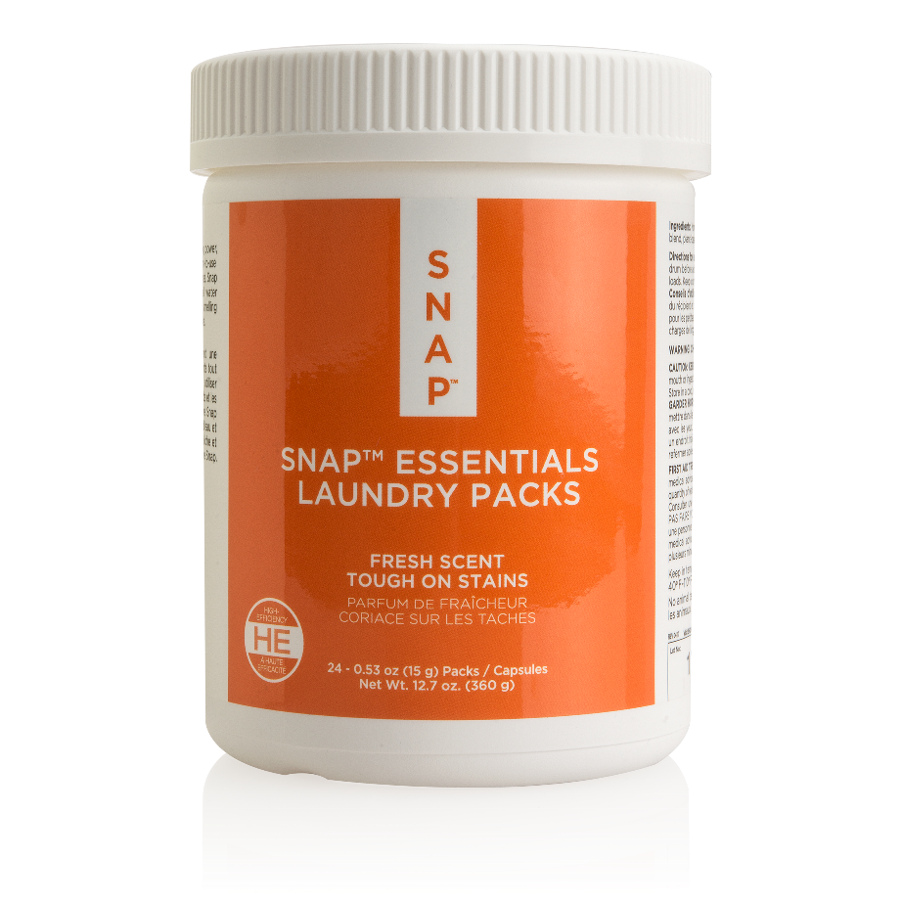
24
LOADS
=
Code: SG6230 |UC: S$16.25| SR: S$22.75|BV: 5
Notes:
Small to medium load (5-7 kg) = 1 pack is needed
Large load (8kg above) = 2 pack is needed

Slide 23
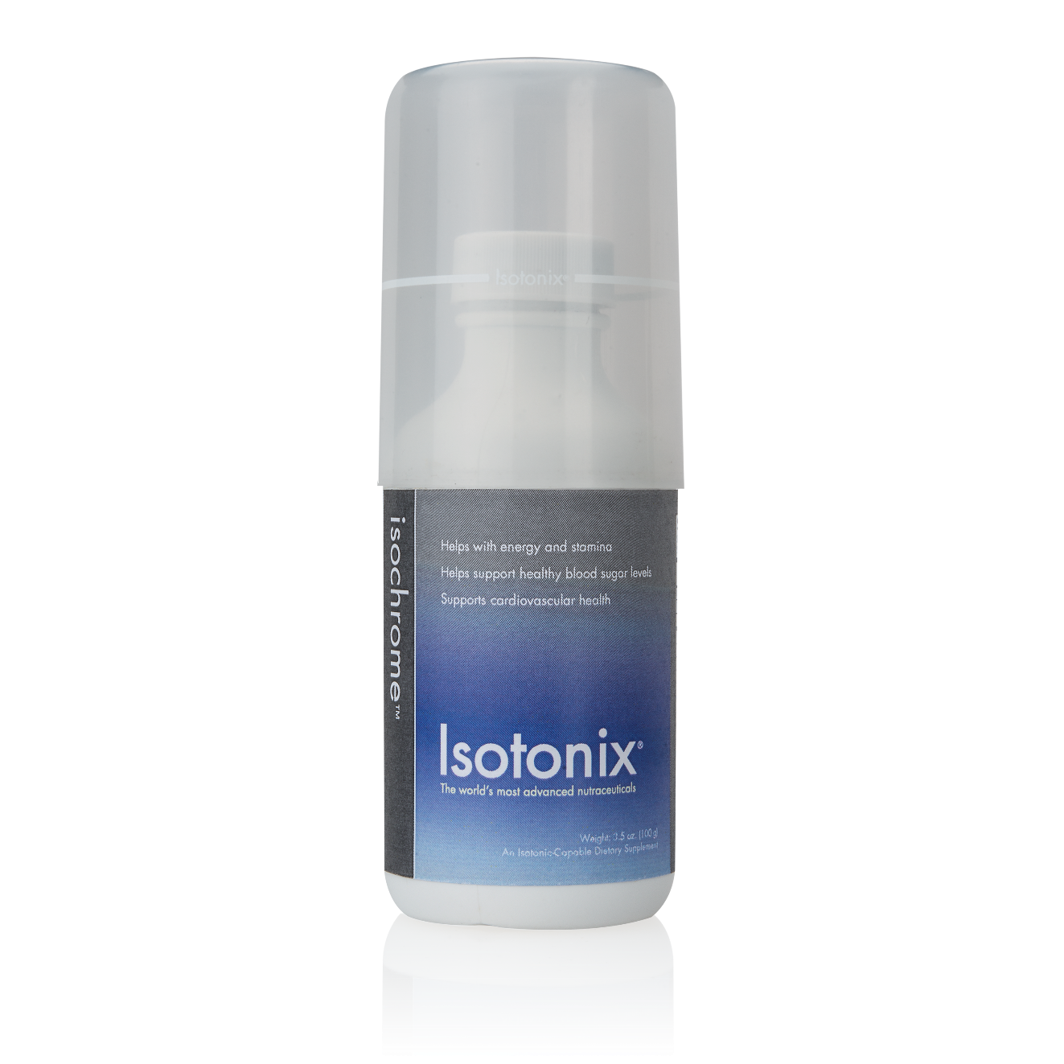
Introducing Isotonix™™ Isochrome
Helps support healthy blood sugar levels
Helps with energy and stamina
Supports cardiovascular health
Code: SG1055 | UC: S$42.75 | SR: S$60.00 | BV:19.50
Isotonix is a registered trademark of Market Singapore in Singapore.

Slide 24
May help to curb appetite
May promote a feeling of fullness
Supports healthy weight management
Promotes fat burning
Contains:
WellTrim® IG (African Mango Seed Extract)
Black Tea Extract
Code: SG6610 |UC: S$46.25| SR: S$64.75|BV: 20
WellTrim® IG is a registered trademark of Icon Group LLC.

